Slide 1
Analytical study oF startups
Under the guidance of:
Prof. Subhajit Dutta
Presented By:
Rohit Kumar
Jayant Jha
Chaitanya

Slide 2
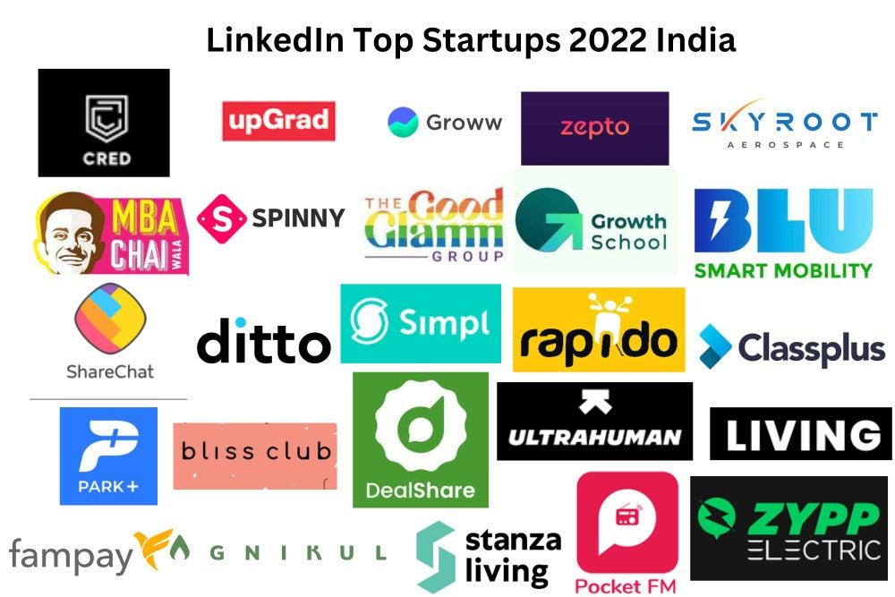
Background on Startups
Startup Ecosystem Resilience:
Global startup ecosystems thrive amidst challenges, nurturing innovation and reshaping industries. Understanding global trends crucial for India's ecosystem resilience.
Regulatory Complexity Impact:
Analyzing regulatory hurdles essential for startups.
Effective policies drive growth, facilitating success in competitive global markets.
Innovation Disruption Dynamics:
Disruption by startups transforms economies globally. Analyzing disruptive factors enables strategic positioning and adaptation for sustainable growth.

Slide 3
Research Questions and Objectives
1. What are the key determinants of startup success within the chosen ecosystem?
2. How do various factors, such as funding sources, industry sector, and geographic location, influence the performance and outcomes of startups?
3. What are the common patterns or trends observed among successful startups, and how do they differ from those of failed startups?
Photo by HANUMAN PHOTO STUDIO🏕️📸 on Pexels

Slide 4

Review
Cluster Analysis in Global Startup Studies:
Global studies employ cluster analysis to segment startups into distinct groups based on innovation activities, growth trajectories, and funding needs. Insights from clusters inform strategic decision-making.
Logistic Regression in Indian Startup Studies:
Indian research utilizes logistic regression to identify success factors like market access, policies, and entrepreneurial skills. Findings guide investment decisions and optimize startup outcomes.
Determining Startup Success Factors:
Statistical techniques uncover critical determinants like market conditions, industry dynamics, and management practices, offering evidence-based guidance for entrepreneurs, investors, and policymakers.

Slide 5
Methodology
1. Data Sources and Collection:
Diverse startup data collected from reputable sources like Kaggle.
Dataset 'CAX_Startup_Data.csv' with 472 companies, 116 attributes cleaned for errors, outliers, and missing values.
2. Measures of Central Tendency and Dispersion:
Calculated mean, median, mode, standard deviation, variance to understand data characteristics.
3. Cluster Analysis: To identify natural groupings or clusters within a dataset based on similarity.
4. Data Visualization Techniques:
Utilized histograms, box plots, scatter plots for visually summarizing data patterns.
5. Machine Learning Techniques:
Logistic Regression, Decision Tree and Random forest to predict the success metric of the startups.

Slide 6
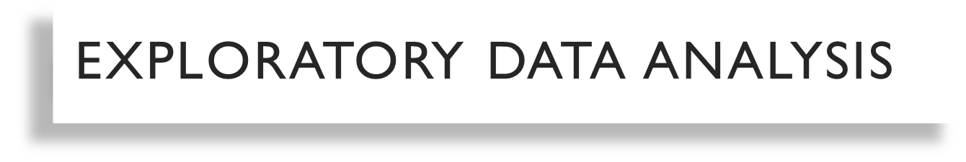
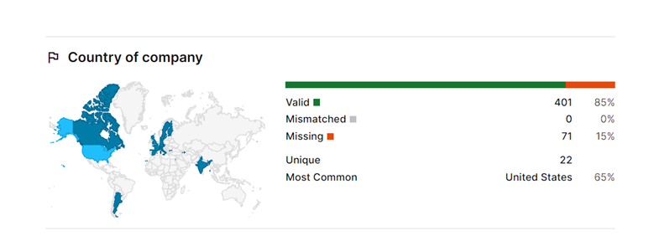
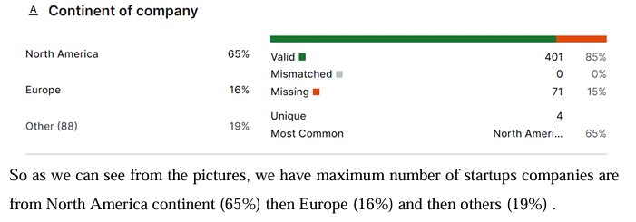
Our dataset is in 472 rows and 116 columns

Slide 7
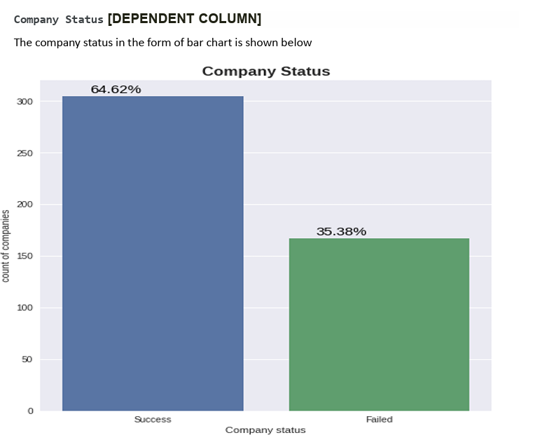
It is concluded from the bar chart that
64.62% companies or startups have succeeded and
35.38% companies or startups have failed
we need to further analyze why a startup fails or succeeds.

Slide 8
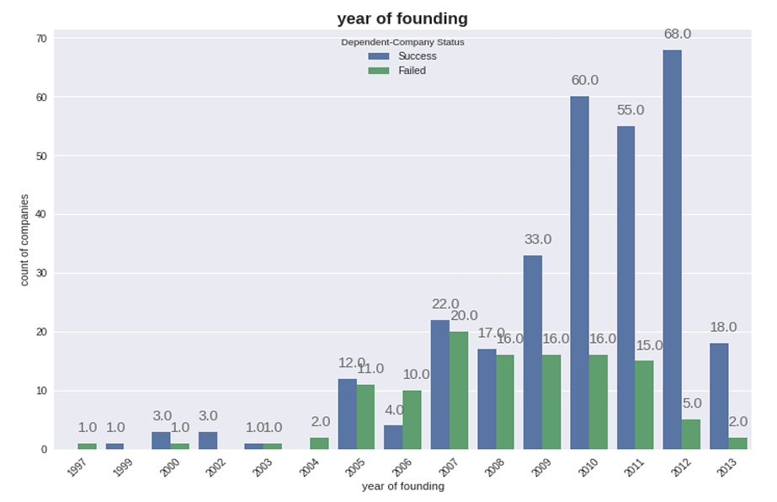
Highest number of companies were found in the year 2010 followed by year 2012 and 2011.
Average number of companies were founded in years 2009, 2007,2005,2008,2013.
The highest success rate of companies is in the year 2012 which is about 93.15%, i.e., near about 93% of startups founded in year 2012 were successful followed by year 2010 with 78.94% and year 2011 with success rate of 78.57% .
The highest failure rate of companies is in the year 2006 which is about 71.42%, i.e. near about 71% of startups founded in year 2006 failed followed by year 2005 with 47.82% and year 2007 with failure rate of 47.61% .

Slide 9
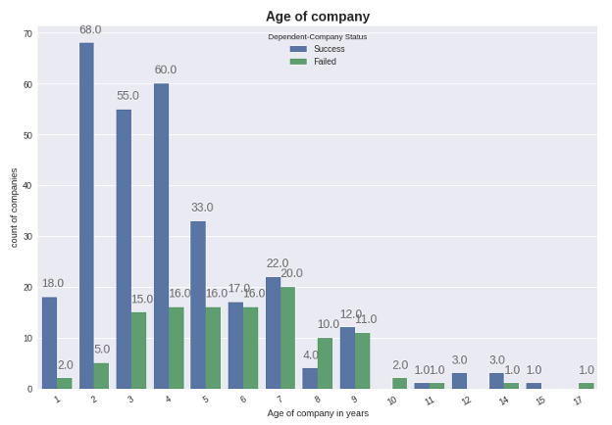
Bar chart
o The age of the companies which have age less than 5 years are more successful.

Slide 10
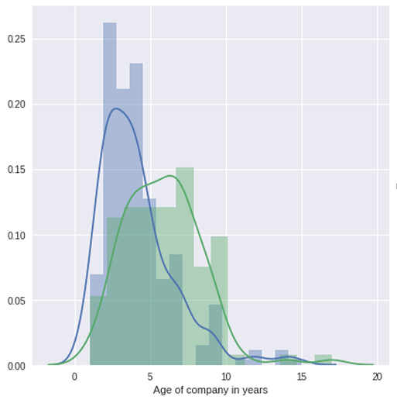
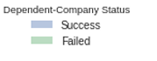
Distribution plot
o From the distribution plot above, we can infer that the Average age of the companies which have succeeded is less than the age of companies which have failed.
o In other words, the companies or startups which have been founded recently are more successful as compared to the older startups.

Slide 11
Cluster Analysis
Outlier detection
1.IQR Method
Normalisation
1. Logarithmic Transformation
Clustering
Algorithms :
1. Hierarchical Clustering
2. K-Means
3. DBSCAN
Precision Metrics:
1. Silhouette Score
2. Davies- Bouldin Index
3. Calinski- Harabasz Index
2. Cubic root Transformation
3. Square Root Transformation
2. Missing Value handling
Visualization
1.Algorithms
Founding Year vs Last Funding Amount
2. Employee Count vs Number of Investor in Seed
3.Age of Company vs Last Round of Funding Received

Slide 12
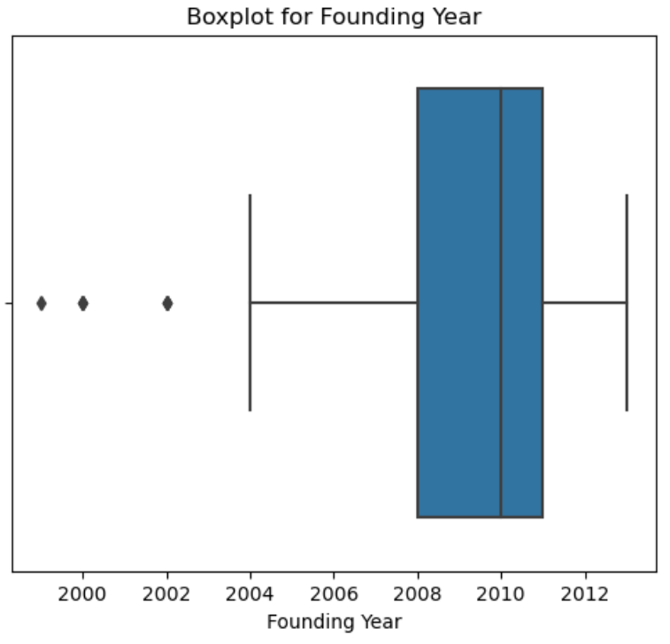
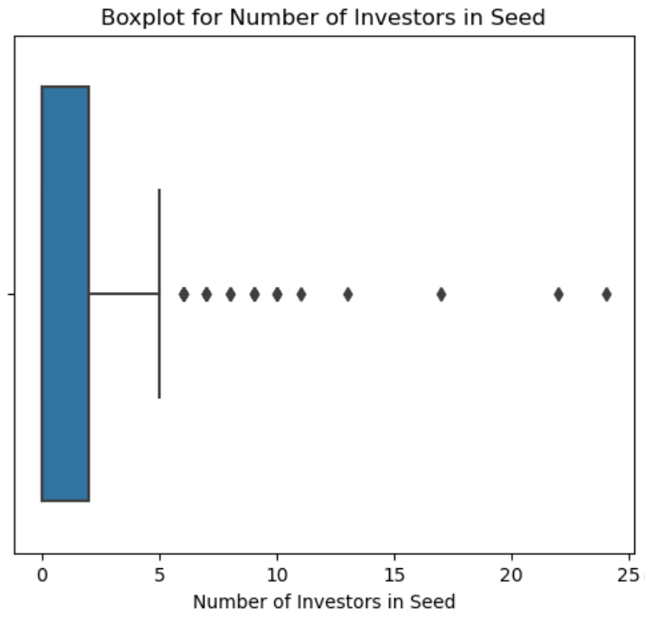
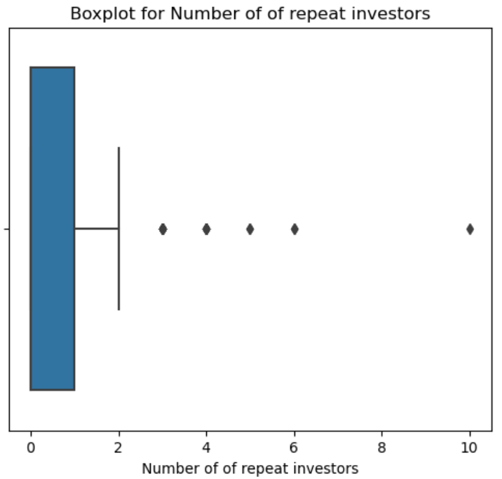
Number of outliers in Founding Year: 7, with percentage as 3.30188679245283 %
Number of outliers in Age of company in years: 7 with Percentage 3.30188679245283 %
Number of outliers in Number of Investors in Seed : 22 with percentage 10.377358490566039 %
Number of outliers in Number of repeat investors: 26, with Percentage 12.264150943396226 %

Slide 13
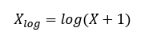
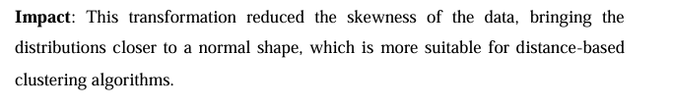
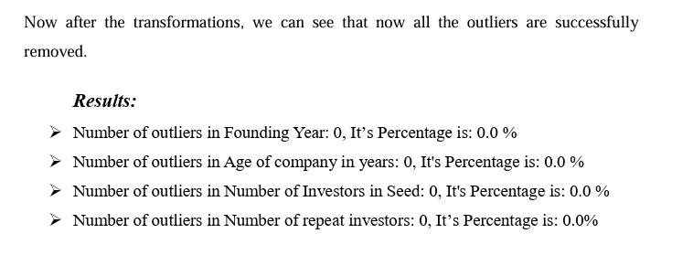
Using Log1p Transformation:
The logarithmic transformation compresses the range of the data by applying the formula:
The skewed distributions were transformed into more normal-like distributions. By normalizing data and handling zeros effectively, it enhances the performance of clustering algorithms, leading to more accurate and interpretable clusters

Slide 14
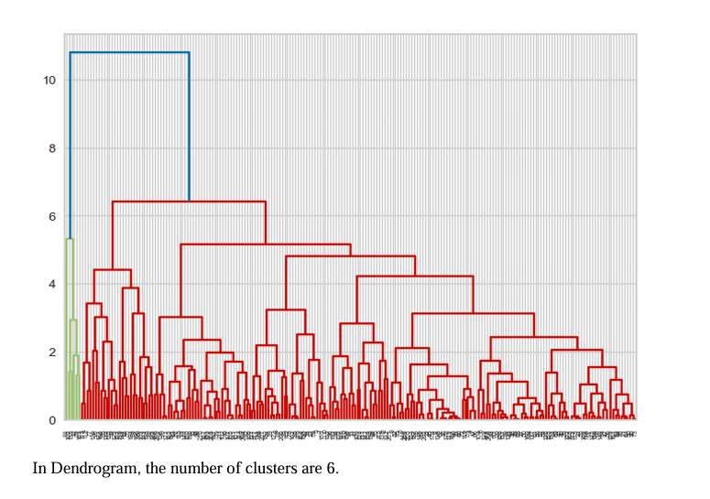
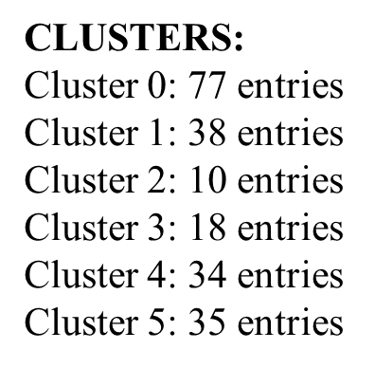
K Means Clustering
CLUSTERING RESULTS:
K-means Clustering
Silhouette Score: 0.34300
Davies-Bouldin Index: 1.01808
Calinski-Harabasz Index: 99.42328

Slide 15
Clustering Metrics
• Silhouette Score: Measures how similar a point is to its own cluster compared to other clusters. The score ranges from -1 to 1.
Interpretation: A high value (close to 1) indicates that points are well matched to their own cluster and poorly matched to neighboring clusters. A negative value indicates that points might be assigned to the wrong cluster.
• Davies-Bouldin Index: Evaluates the average similarity ratio of each cluster with the cluster most similar to it. It is a ratio of within-cluster distances to between-cluster distances.
Interpretation: Lower values indicate better clustering, with zero being the lowest possible value, indicating perfect clustering.
• Calinski-Harabasz Index: Also known as the Variance Ratio Criterion, it measures the ratio of the sum of between-cluster dispersion and within-cluster dispersion.
Interpretation: Higher values indicate better-defined clusters. It is based on the idea that a good clustering result should have high between-cluster dispersion and low within-cluster dispersion.

Slide 16
Visualization and conclusion
Conclusions:
1. Older companies tend to receive higher funding, likely due to their established presence and track record.
2. Recent companies generally have moderate funding, possibly reflecting their emerging status in the market.
3. Companies in Cluster 4, founded very recently, have not yet
attracted significant funding, indicating their nascent stage.
4. The varied range of Cluster 3
indicates high funding is not strictly tied to the founding year, possibly reflecting outlier success stories.
(i) Last funding amount v/s founding year

Slide 17
Conclusion:
1. Companies with more employees generally attract more seed investors (Cluster 2), likely due to their perceived potential and operational scale.
2. Clusters with fewer employees and high investors (Cluster 4 and Cluster 5) suggest some smaller
companies are highly valued by investors, possibly due to their innovative potential.
3. Conversely, some larger companies (Cluster 3) might not have as many seed investors, perhaps reflecting their funding strategies or market saturation
(ii) Employee count v/s Number of Investors in Seed

Slide 18
Conclusions:
Mid-aged companies receive moderate funding, while younger companies secure smaller amounts, highlighting their early-stage status and the cautious investment approach of funders.
Cluster 3 suggests that regardless of age, some companies receive very high funding, possibly due to their significant
Market different ages, indicating no strict correlation between age and funding for all companies.

Slide 19
Recommendations
Investment Strategies:
Investors should consider the company's age and employee count as indicators of stability and growth potential.
2. Company Development:
Startups should focus on building a robust team and demonstrating early successes to attract more investors.
3. Future Clustering:
Further analysis with additional features such as market sector, revenue, and geographic location could provide deeper insights into the clustering patterns and investment strategies.

Slide 20
Definition of the problem:
The objective of this project was to analyse a dataset of 474 startups, clean and preprocess the data, and then apply various machine learning techniques to predict startup success and cluster startups based on key features.
Collect Data:
The dataset, named `CAX_Startup_Data.csv`, sourced from Kaggle.com contains
information on 472 startup companies with a total of 116 attributes against their success
and failure. Here the brief overview of the dataset:
Total entries: 472 Total Columns: 116
Datatypes :
Float64 : 5 columns , int64: 3 columns , object: 108 columns

Slide 21
Preprocess The Data
After preprocessing and cleaning the data, we have a dataset consisting of 212 companies and 10 remaining factors.
We dropped some columns because they were not important to be used in the model.
For cleaning, we used Python code to clean the data.
dataset.dropna(inplace=True)
Dropna(): This is a method called on the DataFrame object. The dropna() method is used to handle missing data in the DataFrame, specifically rows containing missing values.
Inplace=True : By default, dropna() creates a new DataFrame excluding rows with missing values. However,when we set inplace=True, the method modifies the original DataFrame itself instead of creating a new one.
In our project, since the dependent variable (what we're trying to predict) is company status, we need to convert it into a binary format.
Dependent Variable: Company Status (This is what we want to predict)
LabelEncoder: This library function helps convert categorical variables (like company status) into numerical labels (e.g., 0 or 1).

Slide 22

CORRELATION AND MULTICOLLINEARITY ANALYSIS:
The correlation matrix is computed to see how features are related to each other.
Using python code
correlation_matrix = pd.DataFrame(X_train, columns=features.columns).corr()
Here Correlation Matrix
 | Founding Year | Employee Count | Last Funding Amount | Age of company in years | Number of Investors in Seed | Number of repeat investors | Last round of funding received
Founding Year | 1.000 | -0.3874 | -0.2028 | -1.000 | 0.2212 | 0.0427 | -0.2028
Employee Count | -0.3874 | 1.000 | 0.4442 | 0.3874 | -0.1899 | 0.1834 | 0.4442
Last Funding Amount | -0.2028 | 0.4442 | 1.000 | 0.2028 | -0.1830 | 0.1224 | 1.000
Age of company in years | -1.000 | 0.3874 | 0.2028 | 1.000 | -0.2212 | -0.0427 | 0.2028
Number of Investors in Seed | 0.2212 | -0.1899 | -0.1830 | -0.2212 | 1.000 | 0.2824 | -0.1834
Number of repeat investors | 0.0427 | 0.1834 | 0.1224 | -0.0427 | 0.2824 | 1.000 | 0.1224
Last round of funding received | -0.2028 | 0.4442 | 1.000 | 0.2028 | -0.1834 | 0.1224 | 1.000

Slide 23
"We are observing that there is a negative correlation between many variables, so it is being interpreted as...
Interpretation:
Getting Leaner: Older startups might become better at doing things with fewer people, working smarter as they grow.
Changing Direction: Some startups change their plans over time, which might mean letting go of some employees who don't fit with the new plans.
Market Changes: If the market for a startup's product or service changes, the startup might need to adjust its size accordingly.

Slide 24
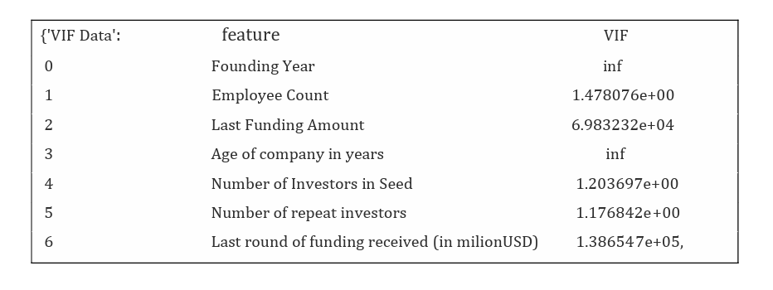
Multicollinearity Check (VIF):
Multicollinearity refers to a situation in statistical modeling where two or more predictor variables (independent variables) are highly correlated, meaning they contain similar information about the variance in the dependent variable (the outcome).
Variance Inflation Factor (VIF) is calculated for each feature to detect multicollinearity.
High VIF values indicate high multicollinearity, which can affect model performance.

Slide 25
Interpretation of VIF
VIF = 1: No correlation between the predictor and other variables.
1 < VIF < 5: Moderate correlation, usually acceptable.
VIF > 5: High correlation, indicates problematic multicollinearity.
Split the dataset:
We have split our data into an 80-20 ratio, with 80% of the data being our training data and 20% of the data being our test data. And we are making predictions for the entire model using only the test data.
By using library from sklearn.model_selection import train_test_split

Slide 26
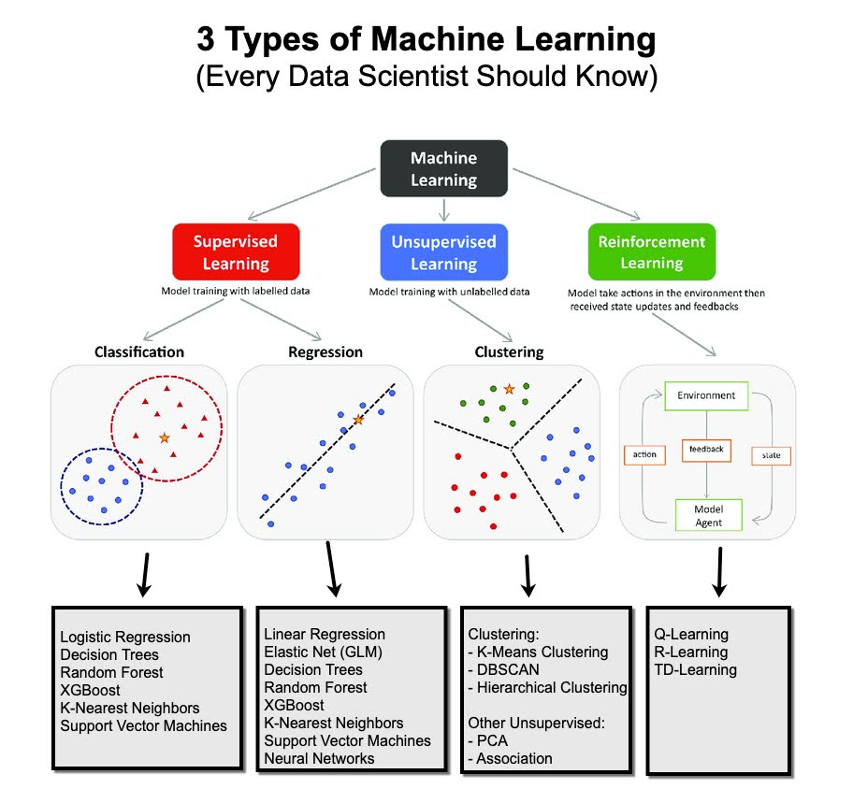
3 TYPES OF MACHINE LEARNING
MACHINE LEARNING

Slide 27
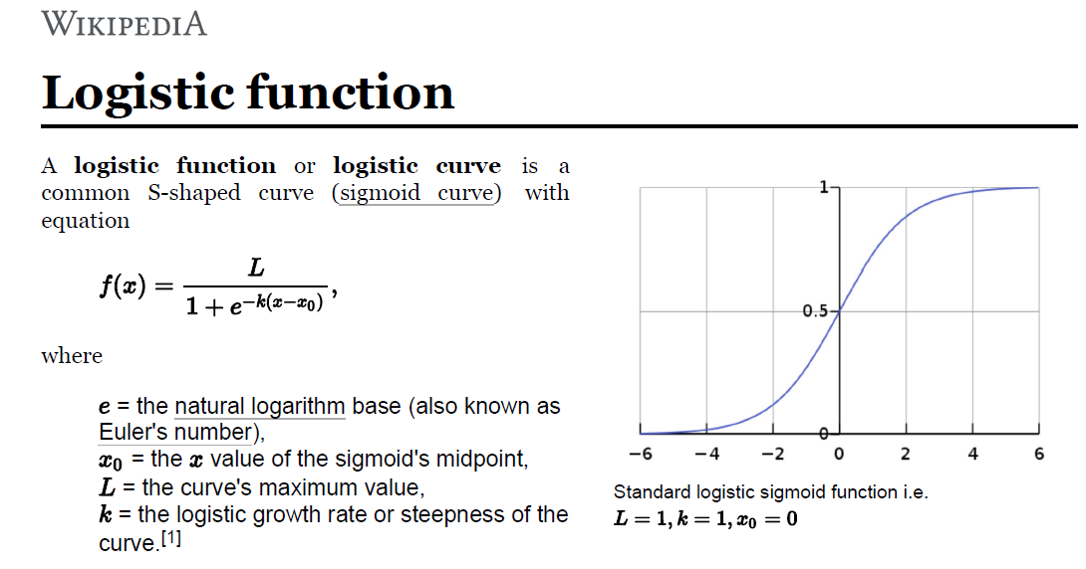
Logistic Regression
The logistic function, also known as the sigmoid function, is an S-shaped curve that maps any real-valued number to a value between 0 and 1.
The logistic function, also known as the sigmoid function, is an S-shaped curve that maps any real-valued number to a value between 0 and 1.

Slide 28
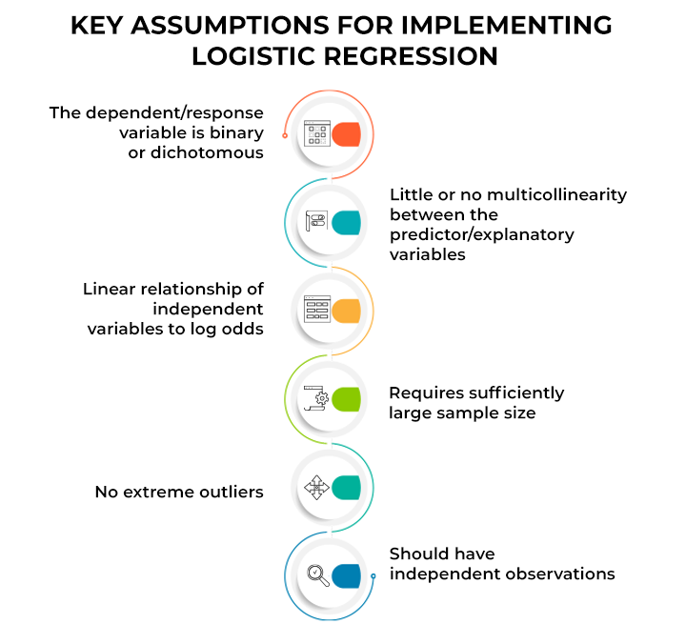

Slide 29
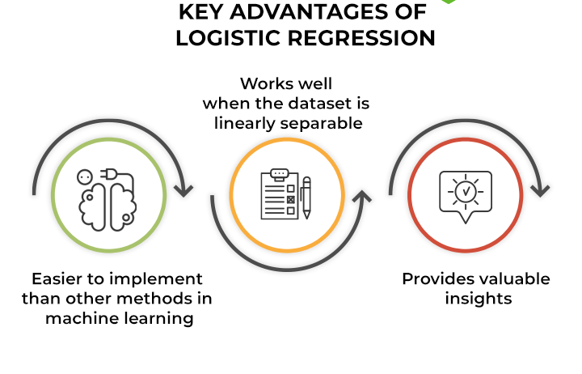
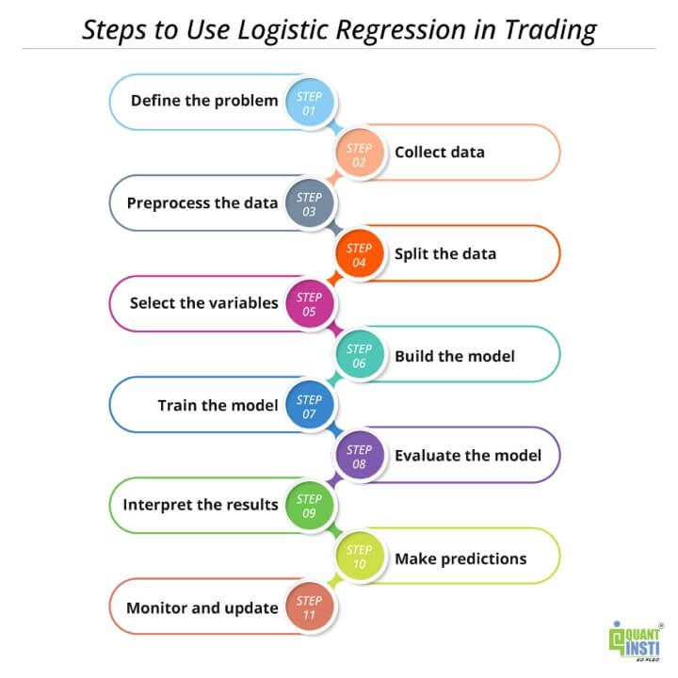
Step To Use Logistic Regression

Slide 30
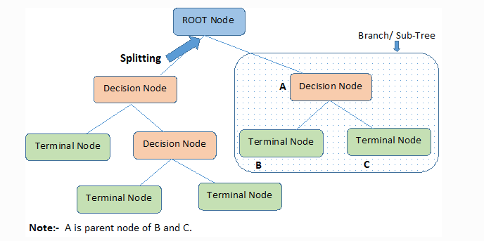
DECISION TREE ALGORITHM
A decision tree is a type of machine learning algorithm that resembles a flowchart. It's used for making predictions or classifications based on a series of questions about the data.
Decision Tree has two properties:
Low bias
High Variance

Slide 31
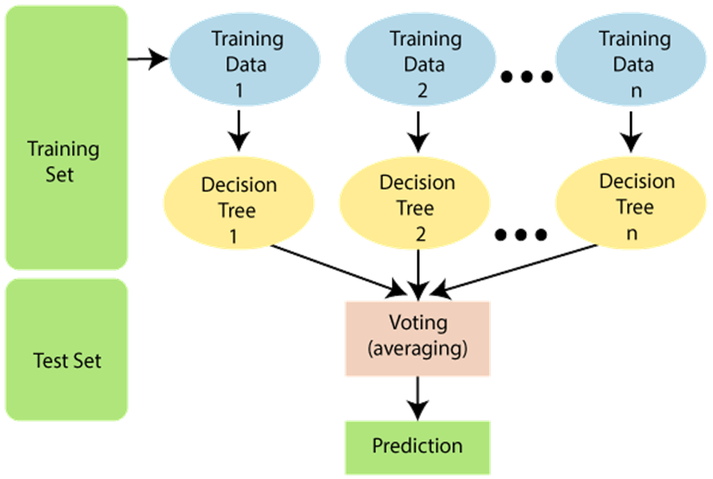
Random forest is a machine learning technique that builds on the concept of decision trees [decision tree]. Imagine a forest instead of a single tree - that's the core idea! It combines the predictions of multiple decision trees to get a more accurate and robust outcome.
When we combine multiple decision trees using majority voting, we achieve a remarkable effect: high variance is transformed into low variance, and the overall error rate is significantly reduced. This leads to enhanced accuracy, making predictions more precise and reliable.
RANDOM FOREST ALGORITHM

Slide 32

Model Performance Metrics:
Accuracy: The proportion of correctly predicted instances over the total instances. It gives a general sense of the model's performance.
Precision: Indicates how many of the predicted positives are actual positives. High precision means fewer false positives.
Recall (Sensitivity): Indicates how many actual positives are correctly predicted. High recall means fewer false negatives.
F1-score: The harmonic mean of precision and recall. It balances the trade-off between precision and recall.
ROC-AUC: Measures the model's ability to distinguish between classes. A higher AUC value indicates better performance.
MACHINE LEARNING TECHNIQUES

Slide 33
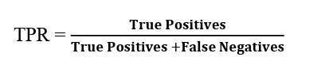
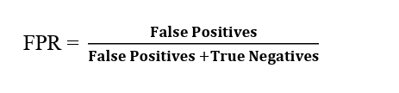
ROC Curve (Receiver Operating Characteristic curve)
The ROC curve is a graphical representation of the performance of a binary classification model. It plots the True Positive Rate (TPR) against the False Positive Rate (FPR) at various threshold settings.
True Positive Rate (TPR), also known as Sensitivity or Recall, is defined as:
False Positive Rate (FPR) is defined as:
AUC (Area Under the Curve)
The AUC represents the area under the ROC curve and provides
a single scalar value to summarize the performance of the model.
The AUC value ranges from 0 to 1
, where:
AUC = 1: The model perfectly distinguishes between all the positive and negative classes.
AUC = 0.5: The model performs no better than random guessing.
AUC < 0.5: The model performs worse than random guessing

Slide 34
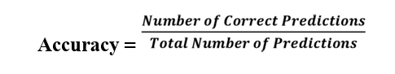
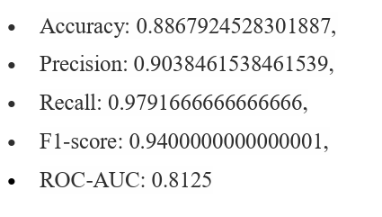
LLL
import pandas as pd
import numpy as np
import seaborn as sns
import matplotlib.pyplot as plt
from sklearn.model_selection import train_test_split
from sklearn.preprocessing import StandardScaler, LabelEncoder
from sklearn.linear_model import LogisticRegression
from sklearn.tree import DecisionTreeClassifier
from sklearn.ensemble import RandomForestClassifier
from sklearn.metrics import accuracy_score, mean_squared_error, r2_score
from statsmodels.stats.outliers_influence import variance_inflation_factor
MODEL TRAINING
LOGISTIC REGRESSION:
Accuracy: 88.67%
MSE : 0.11320 ( showing minimal prediction errors)

Slide 35
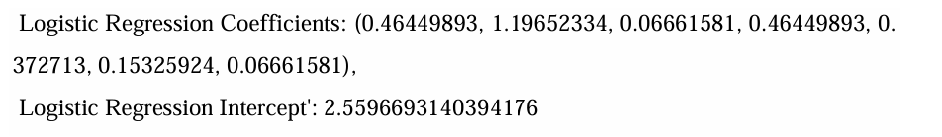
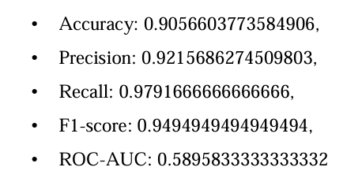
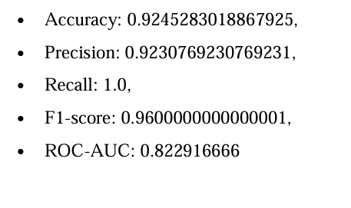
2. Decision Tree Analysis: 3. Random Forest Analysis :

Slide 36
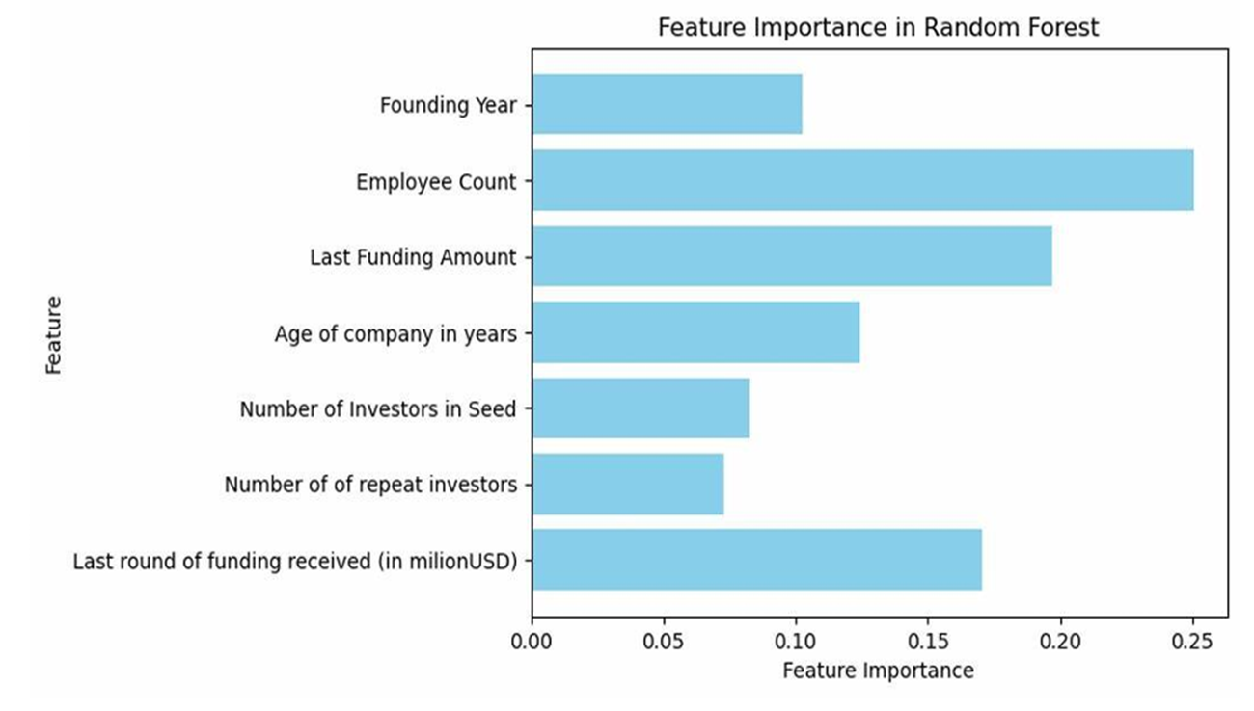
Feature Importance in Random Forest
The random forest model provided insights into which features are most influential in predicting the company status.
Feature Importances: [0.10282555 0.2504885 0.19675679 0.12441246 0.08251287 0.0727347 0.17026913]

Slide 37
• Model Choice: Random Forest trumps Logistic Regression for predicting company status due to better accuracy and handling of complex data.
• Enhancing Predictions: Fine-tuning the Random Forest model and addressing multicollinearity can further improve prediction reliability.
• Key Success Factors: Feature importance analysis reveals number of employees, number of investors, and funding details as critical for success.
• Actionable Insights: These findings inform strategic decisions on resource allocation and guide future research.
Conclusion

Slide 38
REFERENCES
1. Grilli, L., & Murtinu, S. (2014). Government, venture capital and the growth of European high-tech entrepreneurial firms. Research Policy, 43(9), 1523-1543.
2. Autio, E., & Acs, Z. (2010). Global Entrepreneurship Index. GEDI Institute.
3. Baum, J. A. C., & Silverman, B. S. (2004). Picking winners or building them? Alliance, intellectual, and human capital as selection criteria in venture financing and performance of biotechnology startups. Journal of Business Venturing, 19(3), 411-436.
4. The Elements of Statistical Learning (2009) by Trevor Hastie, Robert Tibshirani, and Jerome Friedman
5. Brush, C. G., Edelman, L. F., & Manolov, T. S. (2015). The impact of resources on small firm internationalization. Journal of Small Business Strategy, 15(2), 1-17.
6. Pandey, A., & Jha, S. (2017). Clustering Indian startups: An exploratory study. Journal of Entrepreneurship and Innovation in Emerging Economies, 3(1), 1-14.

Slide 39
7. Sharma, R., & Mathur, N. (2019). Regional analysis of startup ecosystem in India: A clustering approach. International Journal of Business and Economics, 8(3), 267284.
8. Induction of Decision Trees (1986) by J. R. Quinlan: This paper details the ID3 algorithm, a core decision tree learning algorithm.
9. Random Forests (2001) by Leo Breiman: This influential paper introduces the concept of random forests and explores their properties.
10. Agarwal, P., & Upadhyay, A. (2018). Impact of Startup India initiative on startup ecosystem in India: A logistic regression analysis. Journal of Entrepreneurship and Innovation Management, 7(2), 19-35.
11. Jain, A., & Kumar, M. (2020). Determinants of startup success in India: A logistic regression approach. South Asian Journal of Business Studies, 9(1), 22-40.

Slide 40

AAKRITI SEMWAL
VIJAYVEER SINGH RANA

